Slide 1


St. MARTIN’S ENGINEERING COLLEGE
(An Autonomous Institute)
Dhulapally, Secunderabad– 500100
NBA & NAAC A+ ACCREDITED
Effective Biometric Gait Recognition using One Shot Learning Algorithm
Mr. Shubhankar Mahajan (18K81A0554)
Ms. B. Prathyusha (18K81A0513)
Ms. Maryjane Namya (18K81A0538)
Ms. Ashwitha (18K81A0520)
Under the Guidance of
Dr. M. Narayanan
M. Tech, Ph. D
Professor and Head,
Department of Computer Science and Engineering

Slide 2
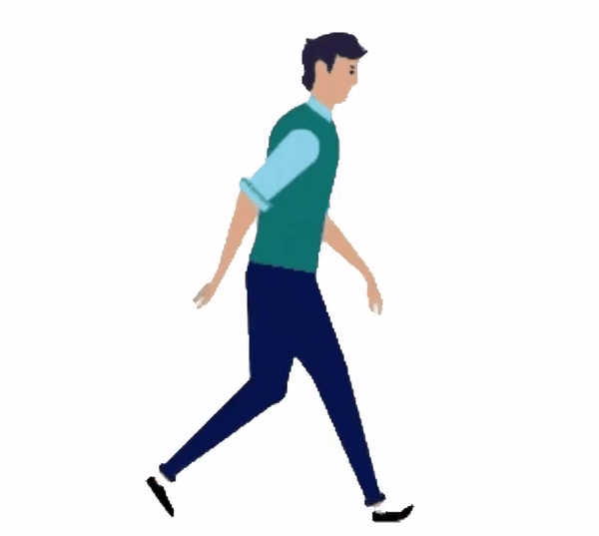
ABSTRACT
Everyone's walking style (gait) is unique, and it has been shown that both humans and computers are very good at recognizing known gait patterns.
This can be used as a biometric form that can be utilized to effectively recognize a person by his/her walking style.

Slide 3

INTRODUCTION
Having to detect faces/acquiring fingerprint to uniquely identify the person in the current situation isn’t ideal and requires cooperation from the people themselves.

Slide 4
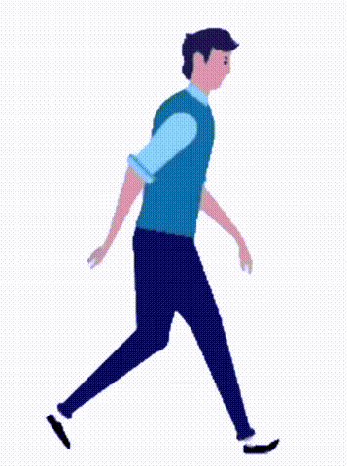
INTRODUCTION
Our project focuses on using techniques such as
Convolutional Neural Network for Gait recognition
Classifiers such as Random Forest, Support Vector Machine (SVM), and Multi Layer Perceptron (MLP) are used for gait recognition with the help of
Local Binary Patterns (LBP)
Histogram of Oriented Gradient (HOG)
Fisher Linear Discriminant Analysis for dimensionality reduction and selecting the most discriminant features for gait recognition.
We also propose on using One Shot Learning Algorithm to improve our results

Slide 5
LITERATURE SURVEY
S. No | Author | Title | Year | Contributions
1. | M. Bukhari | An Efficient Gait Recognition Method for Known and Unknown Covariate Conditions | 2021 | Base Paper
2. | Zhang Rui | A Survey on Biometric Authentication: Toward Secure and Privacy-Preserving Identification | 2018 | Survey on Biometric Authentication
3. | S. S. Harakannanavar | Comprehensive Study of Biometric Authentication Systems, Challenges and Future Trends | 2019 | Biometric Authentication Trends

Slide 6
LITERATURE SURVEY
S. No | Author | Title | Year | Contributions
4. | N. A. Mahadi | A Survey of Machine Learning Techniques for Behavioral-based Biometric User Authentication | 2018 | Machine Learning Example for Biometric Authentication
5. | Saihui Hou | Gait Lateral Network: Learning Discriminative and Compact Representations for Gait Recognition | 2020 | Compact Gait Representations
6. | Hangqing Chao | GaitSet: Regarding Gait as a Set for Cross-View Gait Recognition | 2019 | GaitSet Method

Slide 7
LITERATURE SURVEY
S. No | Author | Title | Year | Contributions
7. | Rijun Liao | A Model-Based Gait Recognition Method With Body Pose and Human Prior Knowledge | 2020 | Model-Based Gait Recognition Example
8. | BeiBei Lin | Gait Recognition via Effective Global-Local Feature Representation and Local Temporal Aggregation | 2021 | Feature Representation
9. | Zitian Chen | Image Deformation Meta-Networks for One-Shot Learning | 2019 | One-Shot Learning Example

Slide 8
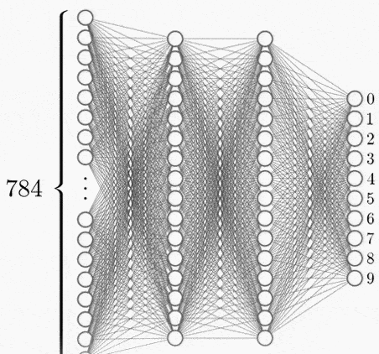
EXISTING SYSTEM
The Existing System in the field of Gait Recognition uses techniques such as Support Vector Machine, Random Forest, Multilayer Perceptron, CNN to classify and recognize the person from the Gait Energy Image (GEI)
Using such systems require training the Model over a large dataset to get proper results which is inefficient in terms of acquiring data and processing it.

Slide 9
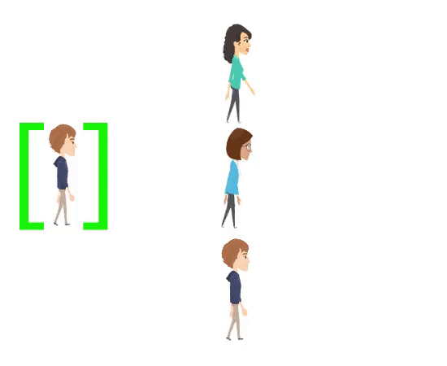
PROPOSED SYSTEM
We propose on removing the need for a large dataset for Training in other models by using One Shot Learning Algorithm.
The algorithm, as the name suggests, uses only one sample to familiarize itself with how a person’s gait should look and then compares it with the testing image to recognize whose gait it is.
Thus, it requires only one GEI (Gait Energy Image) for recognition.

Slide 10


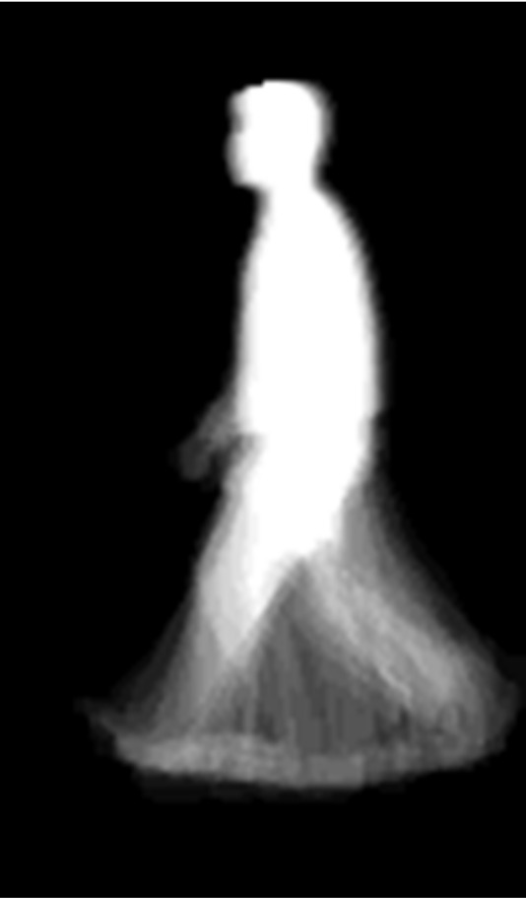
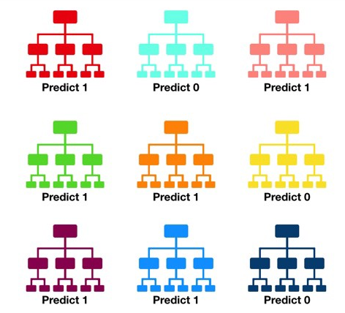
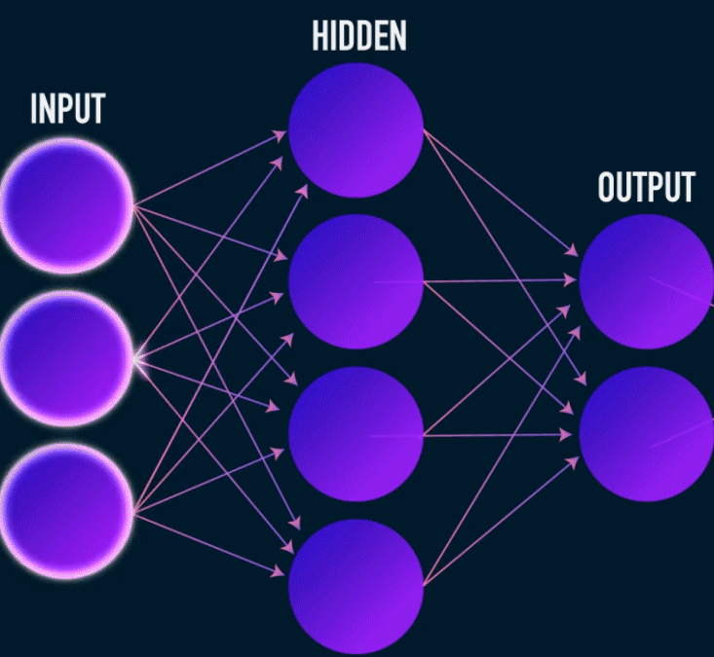

MODULES (SPLIT –UP)
3. Get HOG and LBP Features
4. Apply
One Shot Learning
1. Download Preprocessed Datasets from CBSR
2. Generate GEI from Silhouettes
+
5. Comparison
5.2. Random Forest
5.1. MLP

Slide 11
QUERIES ??

Slide 12
THANK YOU

Slide 13
THANK YOU

